Slide 1
FINAL PROJECT TEMPLATE

Slide 2
THREAT SUMMARY
Summary of Situation: Hospital A, Hospital B and Hospital C have fallen victim to a cyber attack led by what appears to be a group of cyber activists who oppose the new health law that has just been approved. All of the hospitals that were affected had declared their support for the law before being attacked. Our hospital also supports the law and we fear the possibility of a similar attack on us.
Asset: Systems, Control Systems, Patient stats, Doctor reports, Log Analysis tool
Impact: Availability
Threat Actor:
External Threat Actors: Cyber activists motivated by political or social opposition to the new health law. These actors are likely to be organized groups or individuals outside the hospital who seek to disrupt operations as a form of protest.
Internal Threat Actors: Hospital staff who may unintentionally aid the attackers through actions such as falling for phishing scams or other forms of social engineering. There is also the possibility of intentional insider threats from staff members who oppose the law.
Threat Actor Motivation:
• Political/Social Ends: The primary motivation for these attacks is opposition to the newly approved health regulation. The activists aim to disrupt hospital operations to make a political statement or to sway public opinion against the law.
• Financial Gains: Although the current evidence points to hacktivism, the possibility of financially motivated actors should not be dismissed. Groups such as FIN4—a well-known cybercriminal organization—are motivated by financial gain and are known for targeting healthcare institutions to steal sensitive information or deploy ransomware. FIN4 has been particularly active in exploiting vulnerabilities for profit, which could include holding hospital systems hostage until a ransom is paid.
Common Threat Actor Techniques:
• Intentional Threats:
• Phishing: Cyber activists and malicious insiders may use phishing emails to trick hospital staff into revealing sensitive information or downloading malicious software.
• Social Engineering: Techniques such as impersonation or manipulation of staff to gain unauthorized access to hospital systems.
• Insider Threats: Staff members who may intentionally support the attack due to personal beliefs or financial incentive.
• Unintentional Threats:
• Human Error: Unintentional actions by staff, such as clicking on malicious links or mishandling sensitive information, which can facilitate an attack.
• Social Engineering: Even well-meaning staff can be manipulated into actions that compromise security through sophisticated social engineering tactics.

Slide 3
VULNERABILITY SCANNING TARGETS
Summary of scan targets:
Number of devices scanned: Network scan over the entire subnet. Found 1 device
Device type: PC/Server - Windows 10 Pro
Primary purpose of device: Log Server – Personal patients' information

Slide 4
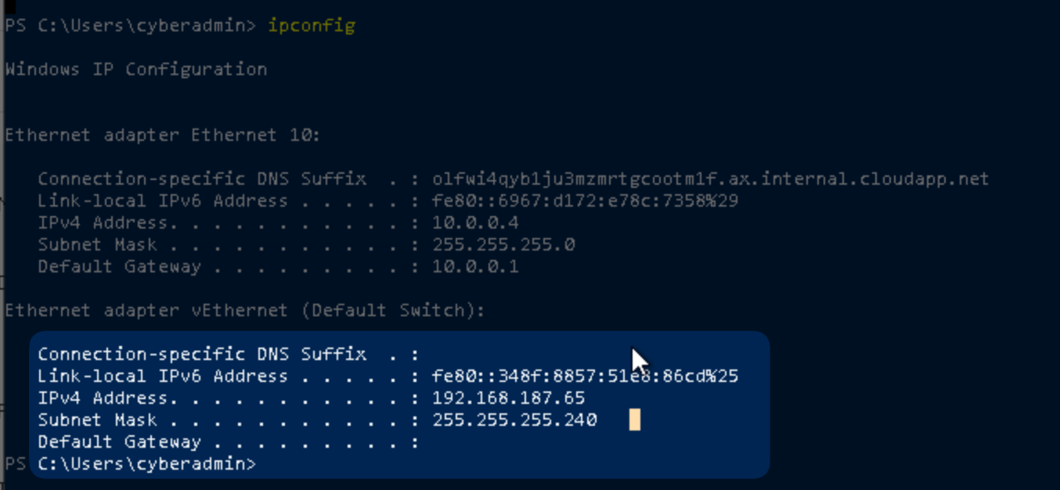
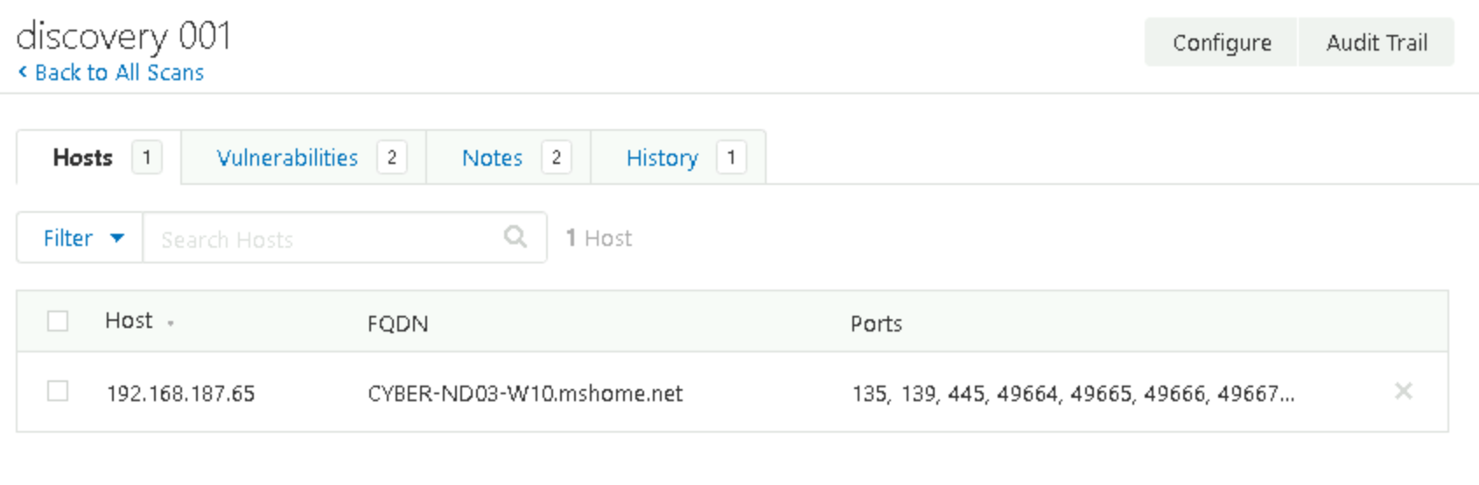
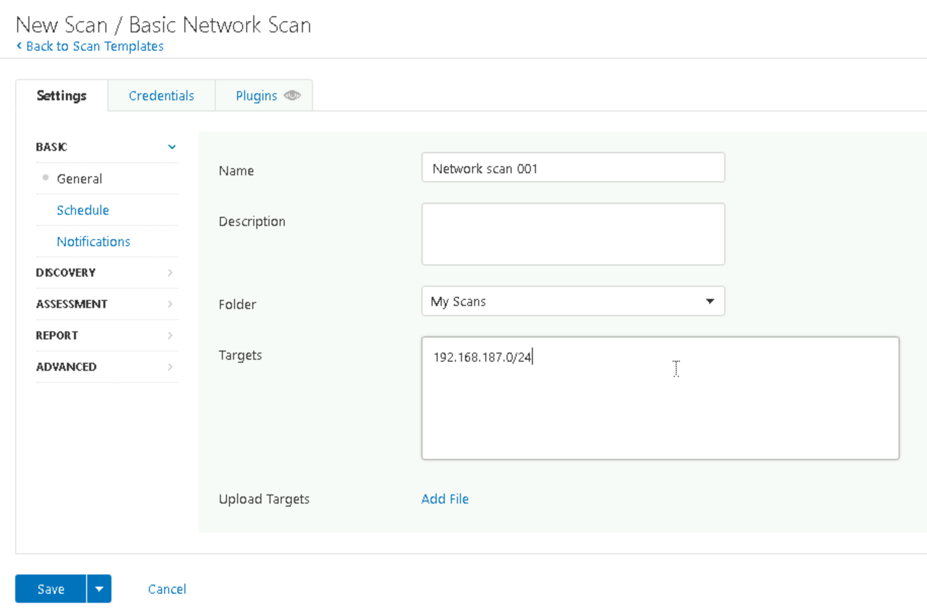
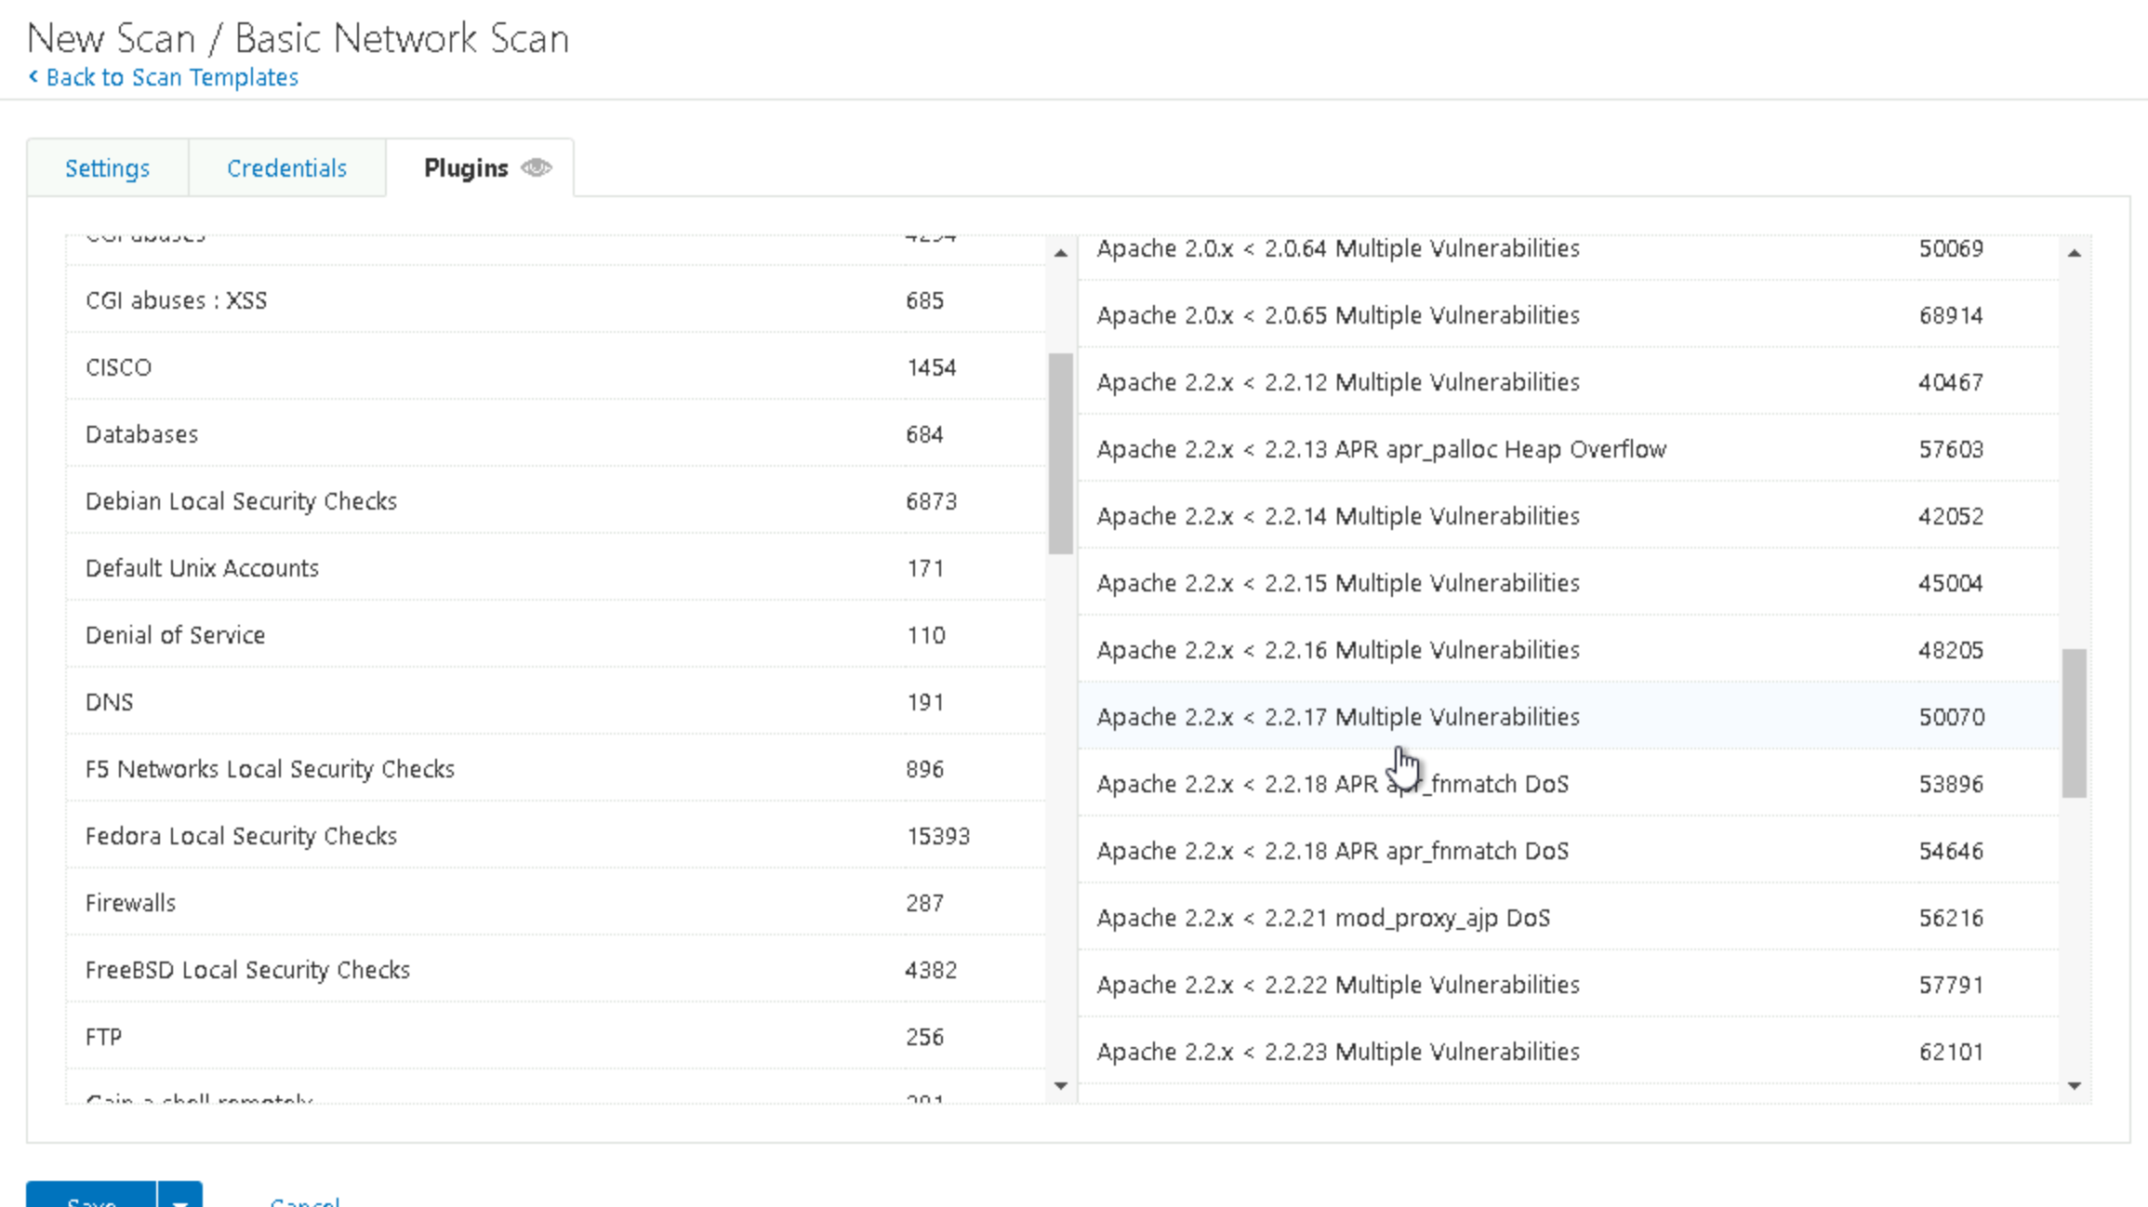

Slide 5
VULNERABILITY SCAN RESULTS
Summary of findings:
Total number of actionable findings:
Critical: 0
High: 0
Medium: 6
Low: 0

Slide 6
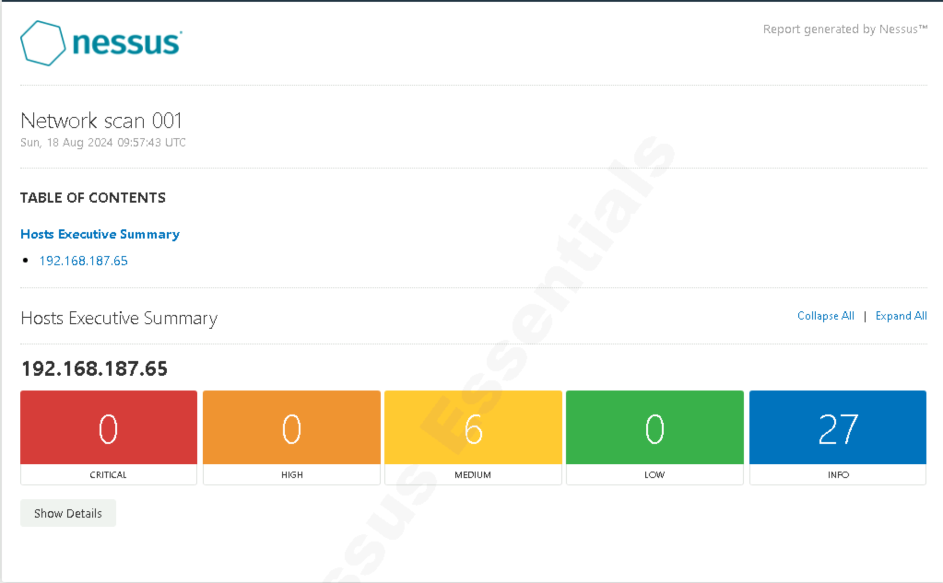

Slide 7
REMEDIATION RECOMMENDATION
Fix within 7 days
Finding | Severity Rating | Recommended Fix
SMB Signin not required | MEDIUM | Implement SMB server signing – Microsoft sign communications (always)
Fix within 30 days
Finding | Severity Rating | Recommended Fix
TLS Version 1.0 detected | Medium | Disable support for
TLS Version 1.1 detected | Medium | Disable support for
Fix within 60 days
Finding | Severity Rating | Recommended Fix
Certificate cannot be trusted | Medium | Generate a signed certificate for msrdp
SSL Self signed Certificate | Medium | Generate a signed certificate for msrdp
SSL Medium Strength Suites Supported | Medium | Reconfigure msrdp to avoid use of m.s.c.

Slide 8
PASSWORD PENETRATION TEST OUTCOME
Methodology:
1. Collected MD5 Hash for passwords
2. Tested MD5 Hash over hashcat dictionary
3. .\hashcat.exe -m 0 -a 0 -D 1,2 -O passwords.txt example.dict
Number of passwords tested: 40
Number of passwords cracked: 34
Evidence of weak passwords: Next slide
Recommended steps to improve passwords security: (Summarize best practice recommendations to avoid brute force attacks in the future)

Slide 9
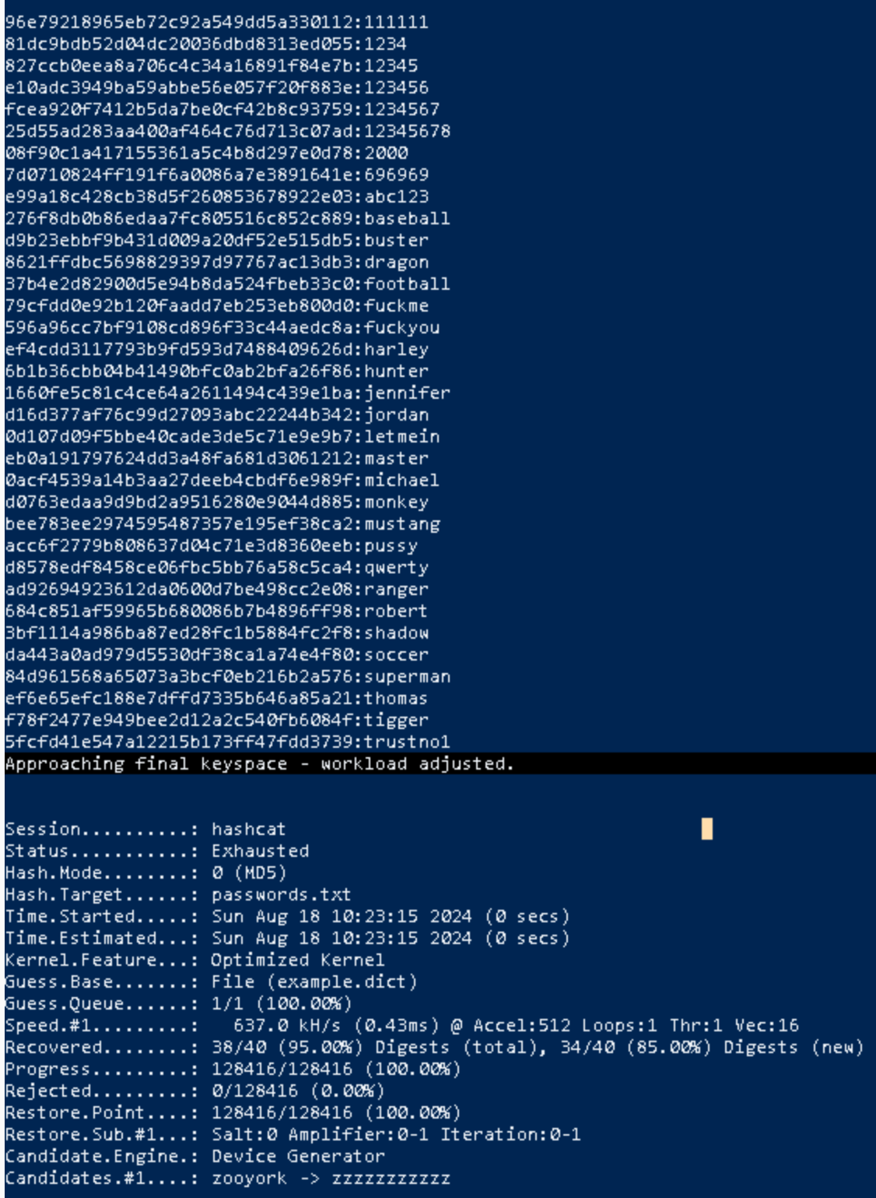
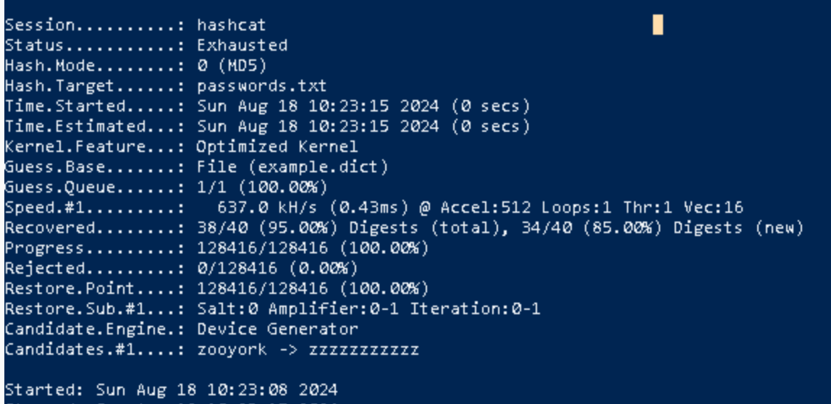

Slide 10
INCIDENT RESPONSE PRELIMINARY ASSESSMENT
Summarize ongoing incident:
A ransomware attack has been reported, affecting multiple systems used by doctors, nurses, and administrative staff. The ransomware demands a payment of one million dollars in Bitcoin to restore access. Critical systems for patient monitoring and treatment have been compromised, and the log analysis tool is no longer accessible. This situation has been declared a critical security incident by the security leader.
Document actions or notes from the following steps of the initial incident response checklist
Step 1: Document that end users discovered the issue
Step 2:
Systems not available anymore
Critical impact
Windows 10 PRO, 192.168.187.65, CYBER-ND03-W10
Step 3:
Incident is confirmed
Incident is still in progress
Response is urgent
Not sure. We don’t care.
Ransomware
Step 4: The lives of the staff are not at risk. The lives of the patients could be at risk.
Step 6: Category A "A threat to public safety or life." The attack compromises access to clinical care for hospital patients. The other categories, while all true, are of lesser relevance.

Slide 11
INCIDENT RESPONSE RECOMMENDED ACTION
Summarize recommendation to contain, eradicate, and recover:
1. Containment:
• Isolate Affected Systems: Immediately disconnect infected systems from the network to prevent further spread of the ransomware.
• Shutdown Non-Essential Systems: Temporarily shut down other vulnerable systems to avoid additional infections.
• Activate the Incident Response Team: Mobilize the team to handle the situation, ensuring roles and responsibilities are clearly defined.
2. Eradication:
• Remove the Ransomware: Utilize antivirus and anti-malware tools to thoroughly clean the infected systems.
• Patch Vulnerabilities: Identify and fix any vulnerabilities that the ransomware exploited to ensure it doesn’t reoccur.
• Secure Systems: Ensure that all traces of the ransomware are eradicated before reconnecting systems to the network.
3. Recovery:
• Restore from Clean Backups: Use the most recent, unaffected backups to restore critical systems.
• Validate System Integrity: Verify that restored systems are functioning properly and are free from ransomware.
• Monitor for Recurrence: Implement enhanced monitoring to detect any signs of lingering threats or re-infection.

Slide 12
INCIDENT RESPONSE RECOMMENDED ACTION
Documented actions and notes from the IR checklist
Step 7: Malware procedure. According to the IR document it is required to wipe affected devices clean and fully restore from backup
Step 8:
Authorization status: At this time, I have not received explicit authorization to review system logs related to the ransomware attack. Without access to these logs, I am unable to directly analyze the sequence of events or identify potential indicators of compromise within the system.
Alternative Actions:
Engage Authorized Personnel: I recommend that authorized members of the Incident Response (IR) team, who have the necessary permissions, perform a thorough review of the system logs. This will include checking security logs, event logs, and any other relevant logs on affected systems and network devices.
Request a Summary: If direct access to logs is not granted, I will request a summary report from the authorized personnel detailing key findings from their log review.
Step 9:
Re-install the affected system(s) from scratch and restore data from backups if necessary. Preserve evidence before doing this.
Make users change weak passwords (view slide 9)
Fix SMB vulnerability discovered (view slide 7)
Be sure real time malware protection is enabled on all devices
Step 12:
I suggest implementing a SIEM system like Wazuh with the application of appropriate active response criteria.
The response was appropriate. The procedure included an explicit reference to the possibility of Ransomware attacks, supported by an operational procedure for removing the infection.
We have learned that Ransomware attacks can occur very quickly and cause the Availability of computer systems to fail in very short time frames.

